Slide 1


Segmentation and torch

Slide 2
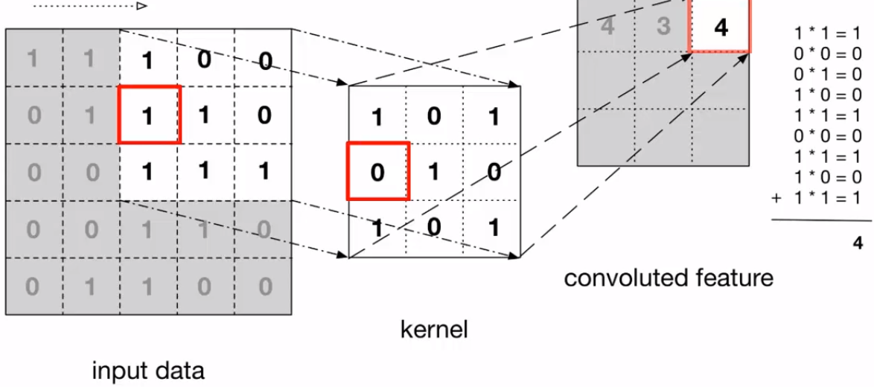

CNN

Slide 3
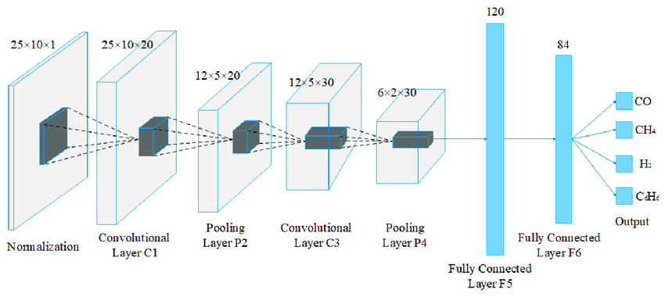
LeNet

Slide 4
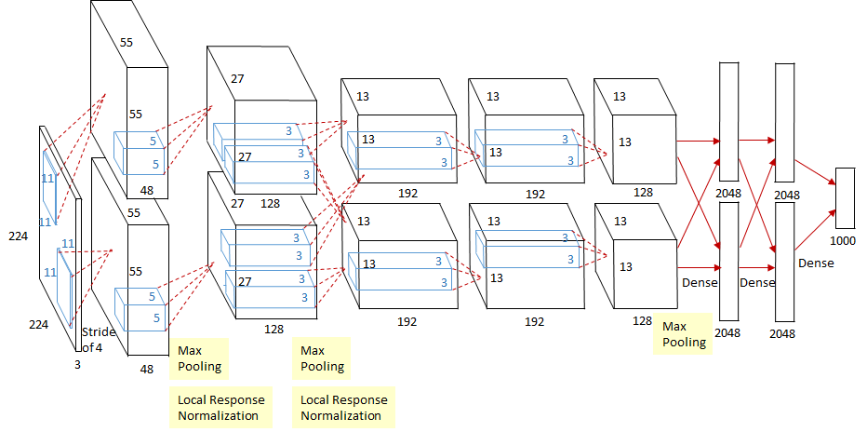

AlexNet

Slide 5
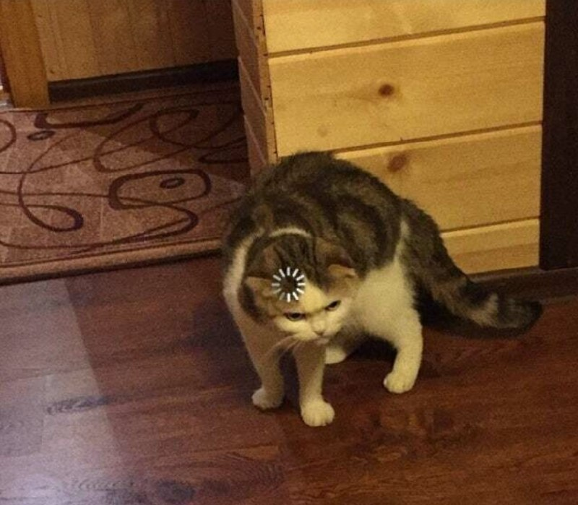
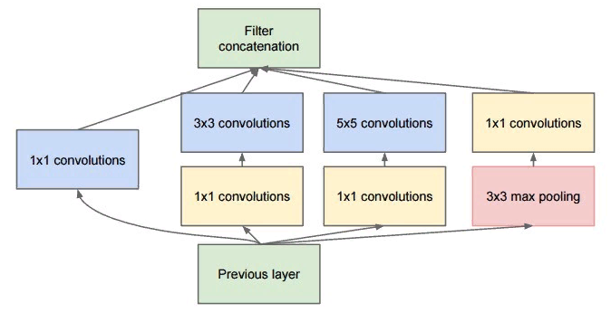
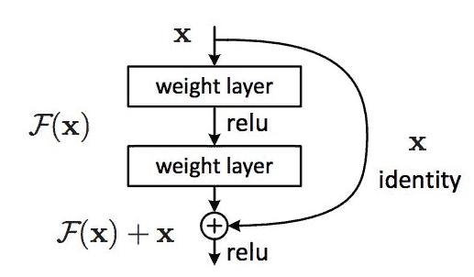
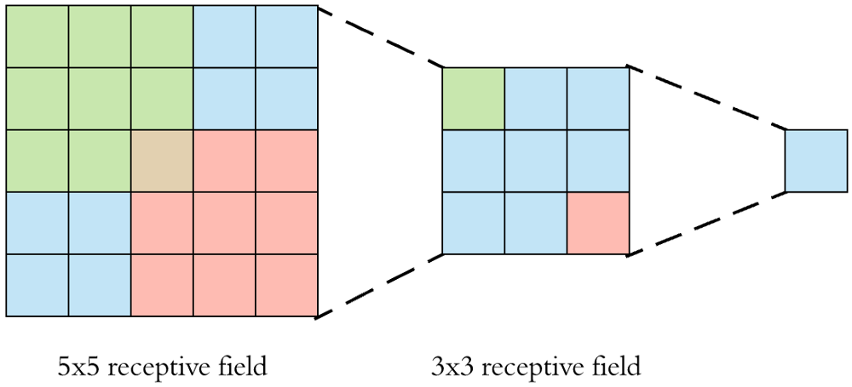
Receptive field, Inception block, residual block, ....

Slide 6
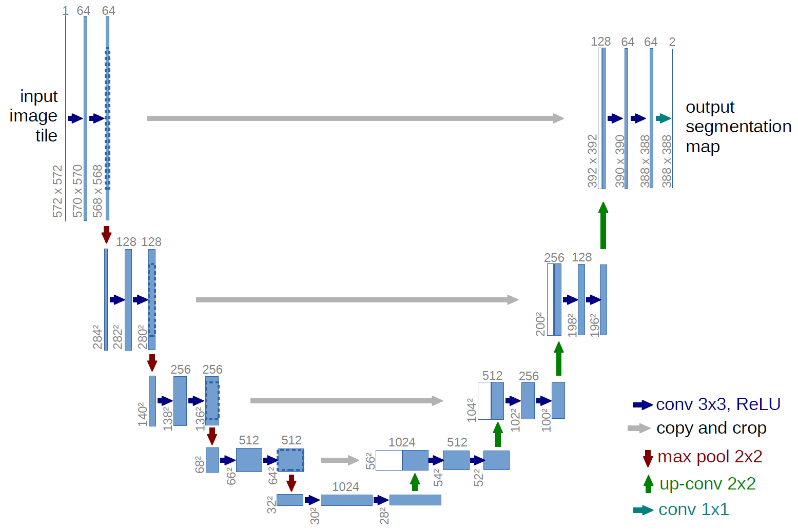
U-net and skip connection

Slide 7
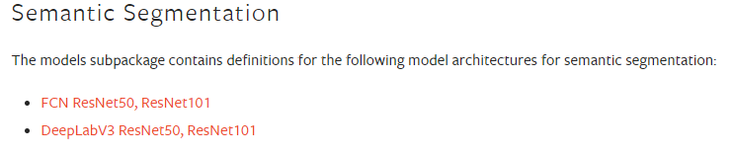
torch models

Slide 8
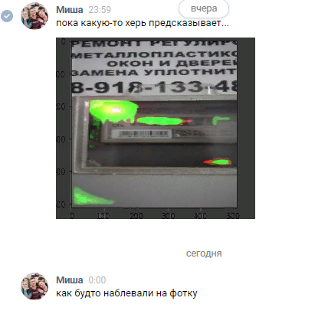
Loss functions
Cross Entropy (Binary Cross Entropy)
IoU
Dice
My loss = cross_entropy * ce_weight + dice * (1 - ce_weight)
My metrics = [ce_loss, dice_loss, My loss]

Slide 9
Links
Deconvolution:
https://pytorch.org/docs/master/generated/torch.nn.ConvTranspose2d.html
https://pytorch.org/docs/master/nn.html#vision-layers
https://pytorch.org/docs/master/nn.html#pooling-layers
Dropout:
https://pytorch.org/docs/master/nn.html#dropout-layers
Torchvision models:
https://pytorch.org/docs/master/torchvision/models.html

